Slide 1




Slide 2


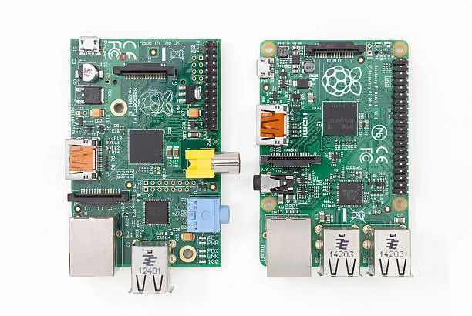


RASPBERRY PI
WHAT IS IT?
THE RASPBERRY PI IS A LOW-COST, CREDIT-CARD SIZED COMPUTER. UNLIKE A MICROCONTROLLER, IT RUNS A FULL OPERATING SYSTEM (LINUX), ALLOWING IT TO HANDLE MULTIPLE TASKS, BROWSE THE WEB, AND RUN COMPLEX SOFTWARE.
SPECIALTIES FOR BEGINNERS
CODING HUB: THE PERFECT ENVIRONMENT TO LEARN PYTHON, JAVA, OR NODE.JS DIRECTLY ON THE DEVICE WITHOUT A SECOND PC.
MEDIA & AI: EXCEL AT HIGH-LEVEL TASKS LIKE VIDEO STREAMING, FACE RECOGNITION, AND LOCAL CLOUD STORAGE (NAS).
GPIO PINS: DESPITE BEING A COMPUTER, IT STILL HAS 40 PINS TO CONTROL LEDS, SENSORS, AND MOTORS JUST LIKE AN ARDUINO.
WHY USE IT?
DESKTOP POWER: IT HAS HDMI, USB, AND ETHERNET PORTS, MAKING IT A FULLY FUNCTIONAL PC THAT FITS IN YOUR POCKET.
MULTITASKING: RUNS MULTIPLE PROGRAMS SIMULTANEOUSLY, SUCH AS A WEB SERVER, DATABASE, AND AI MODEL ALL AT ONCE.
OS FLEXIBILITY: SUPPORTS VARIOUS OPERATING SYSTEMS, FROM RASPBERRY PI OS TO UBUNTU AND EVEN MEDIA CENTERS.

Slide 3

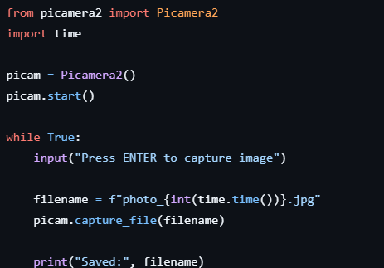
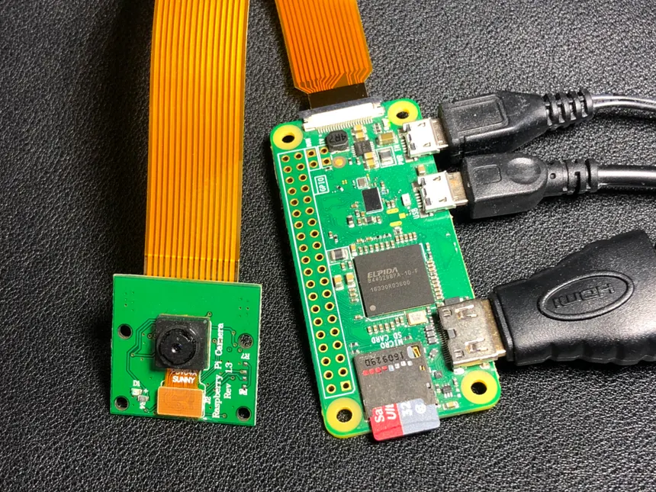
capture test with Raspberry Pi

Slide 4
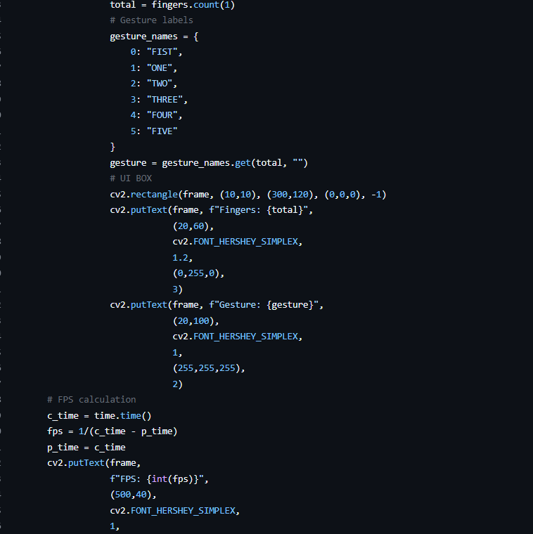
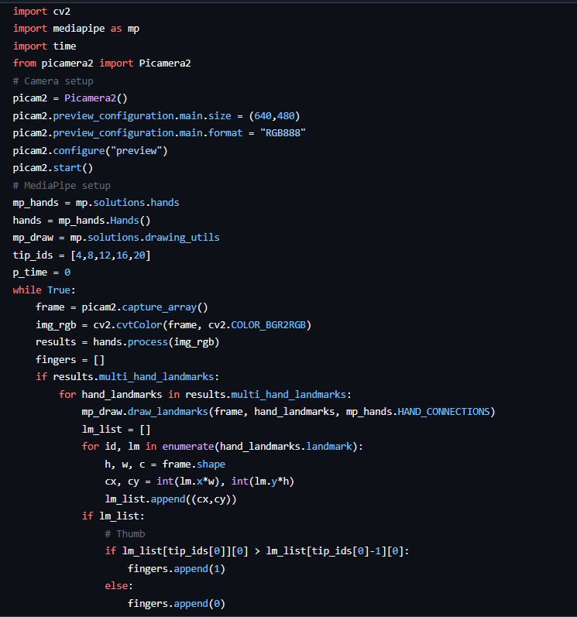
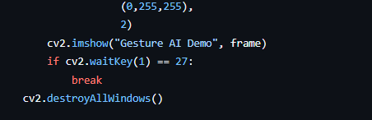
finger counter with
Raspberry Pi

Slide 5
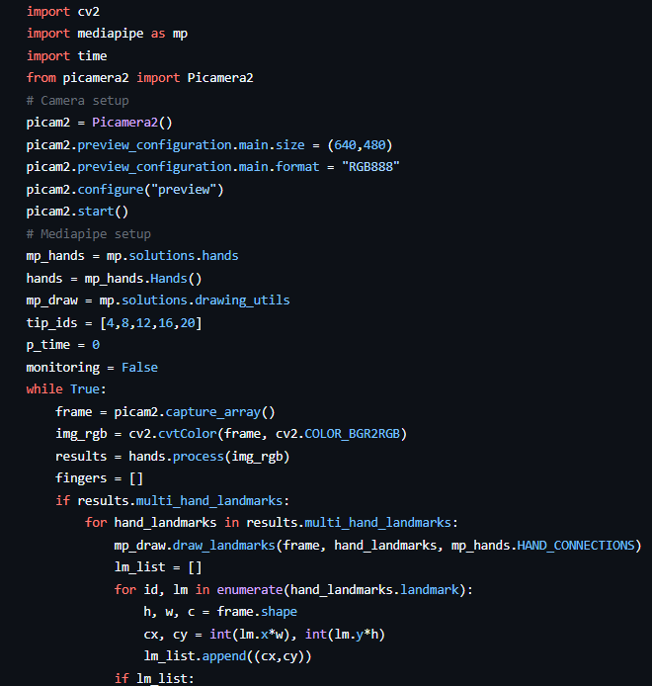
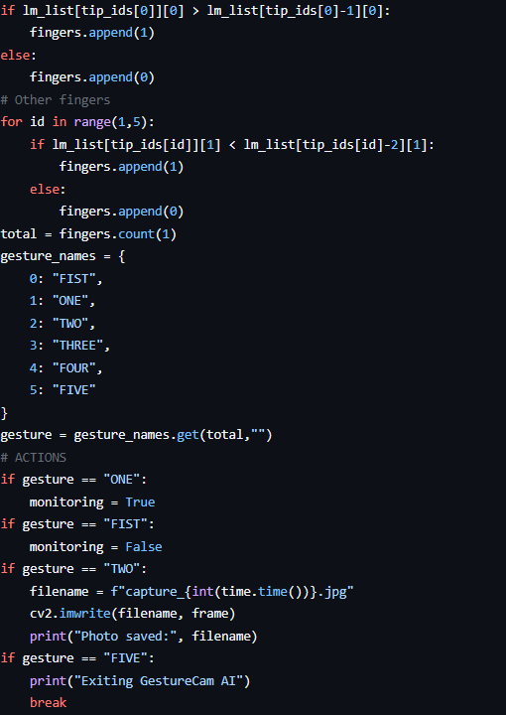
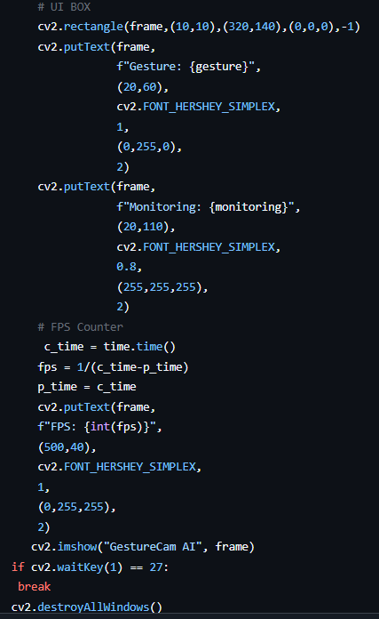
GESTURECAM AI WITH RASPBERRY PI

Slide 6
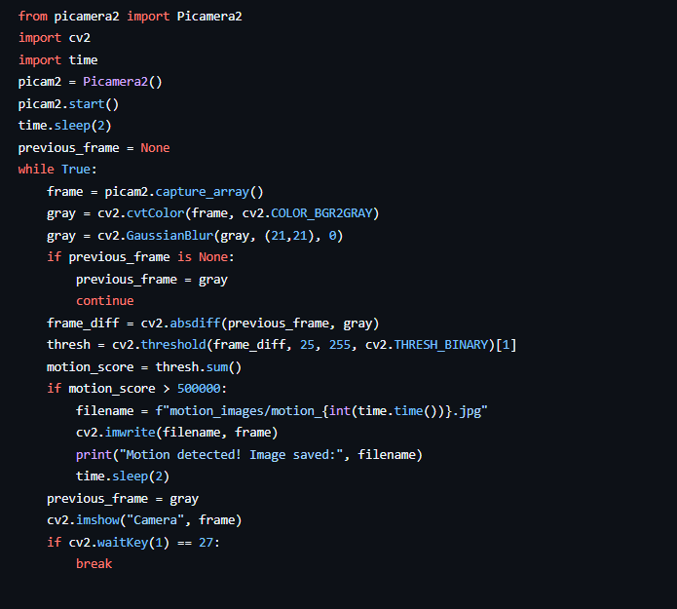
motion detection with Raspberry Pi

Slide 7
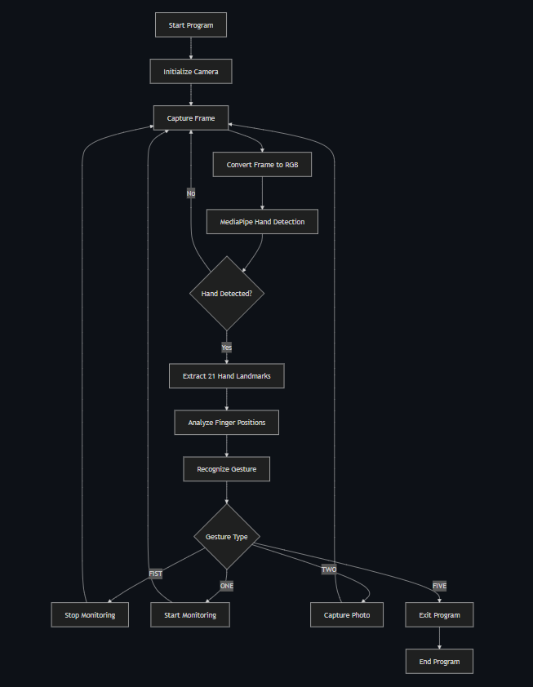
SYSTEM WORKFLOW

Slide 8
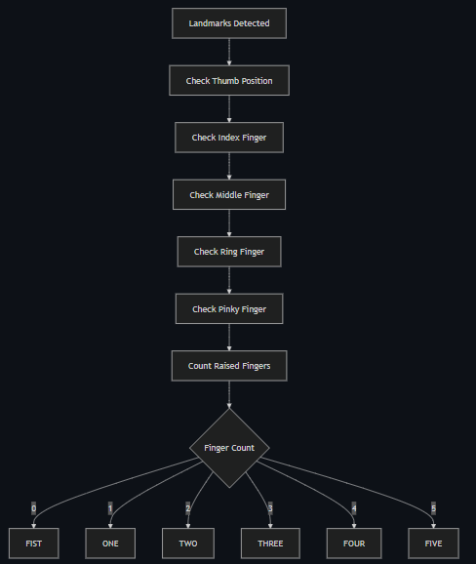
GESTURE RECOGNITION LOGIC

Slide 9
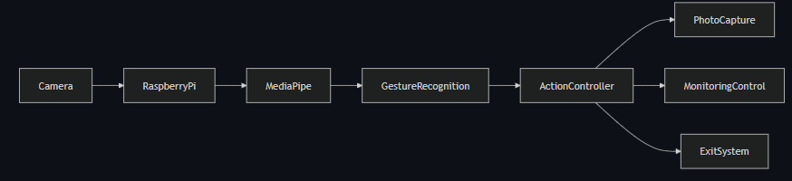
HIGH-LEVEL SYSTEM ARCHITECTURE

Slide 10

Git and Github
GIT (The LOCAL Tool)
Function: Distributed Version Control System. It manages the history of your project files on your local machine.
Workflow: Modified files move from the Working Directory, through the Staging Area, and into the Local Repository (the hidden .git folder).
Key Action: A commit is a secure, compressed snapshot of all staged files, permanently recorded in the project's history.
GITHUB (The CLOUD Platform)
Function: Web-based Git Repository Hosting Service. It provides a remote location for your local Git repositories.
Interactions: You push new local commits up to GitHub and pull new changes from GitHub down to your local machine.
Key Action: Pull Requests are formal proposals on GitHub to merge a remote branch, used for code review and team discussion.
Scan here
You can download the code from here

Slide 11

THANK YOU

